Slide 1

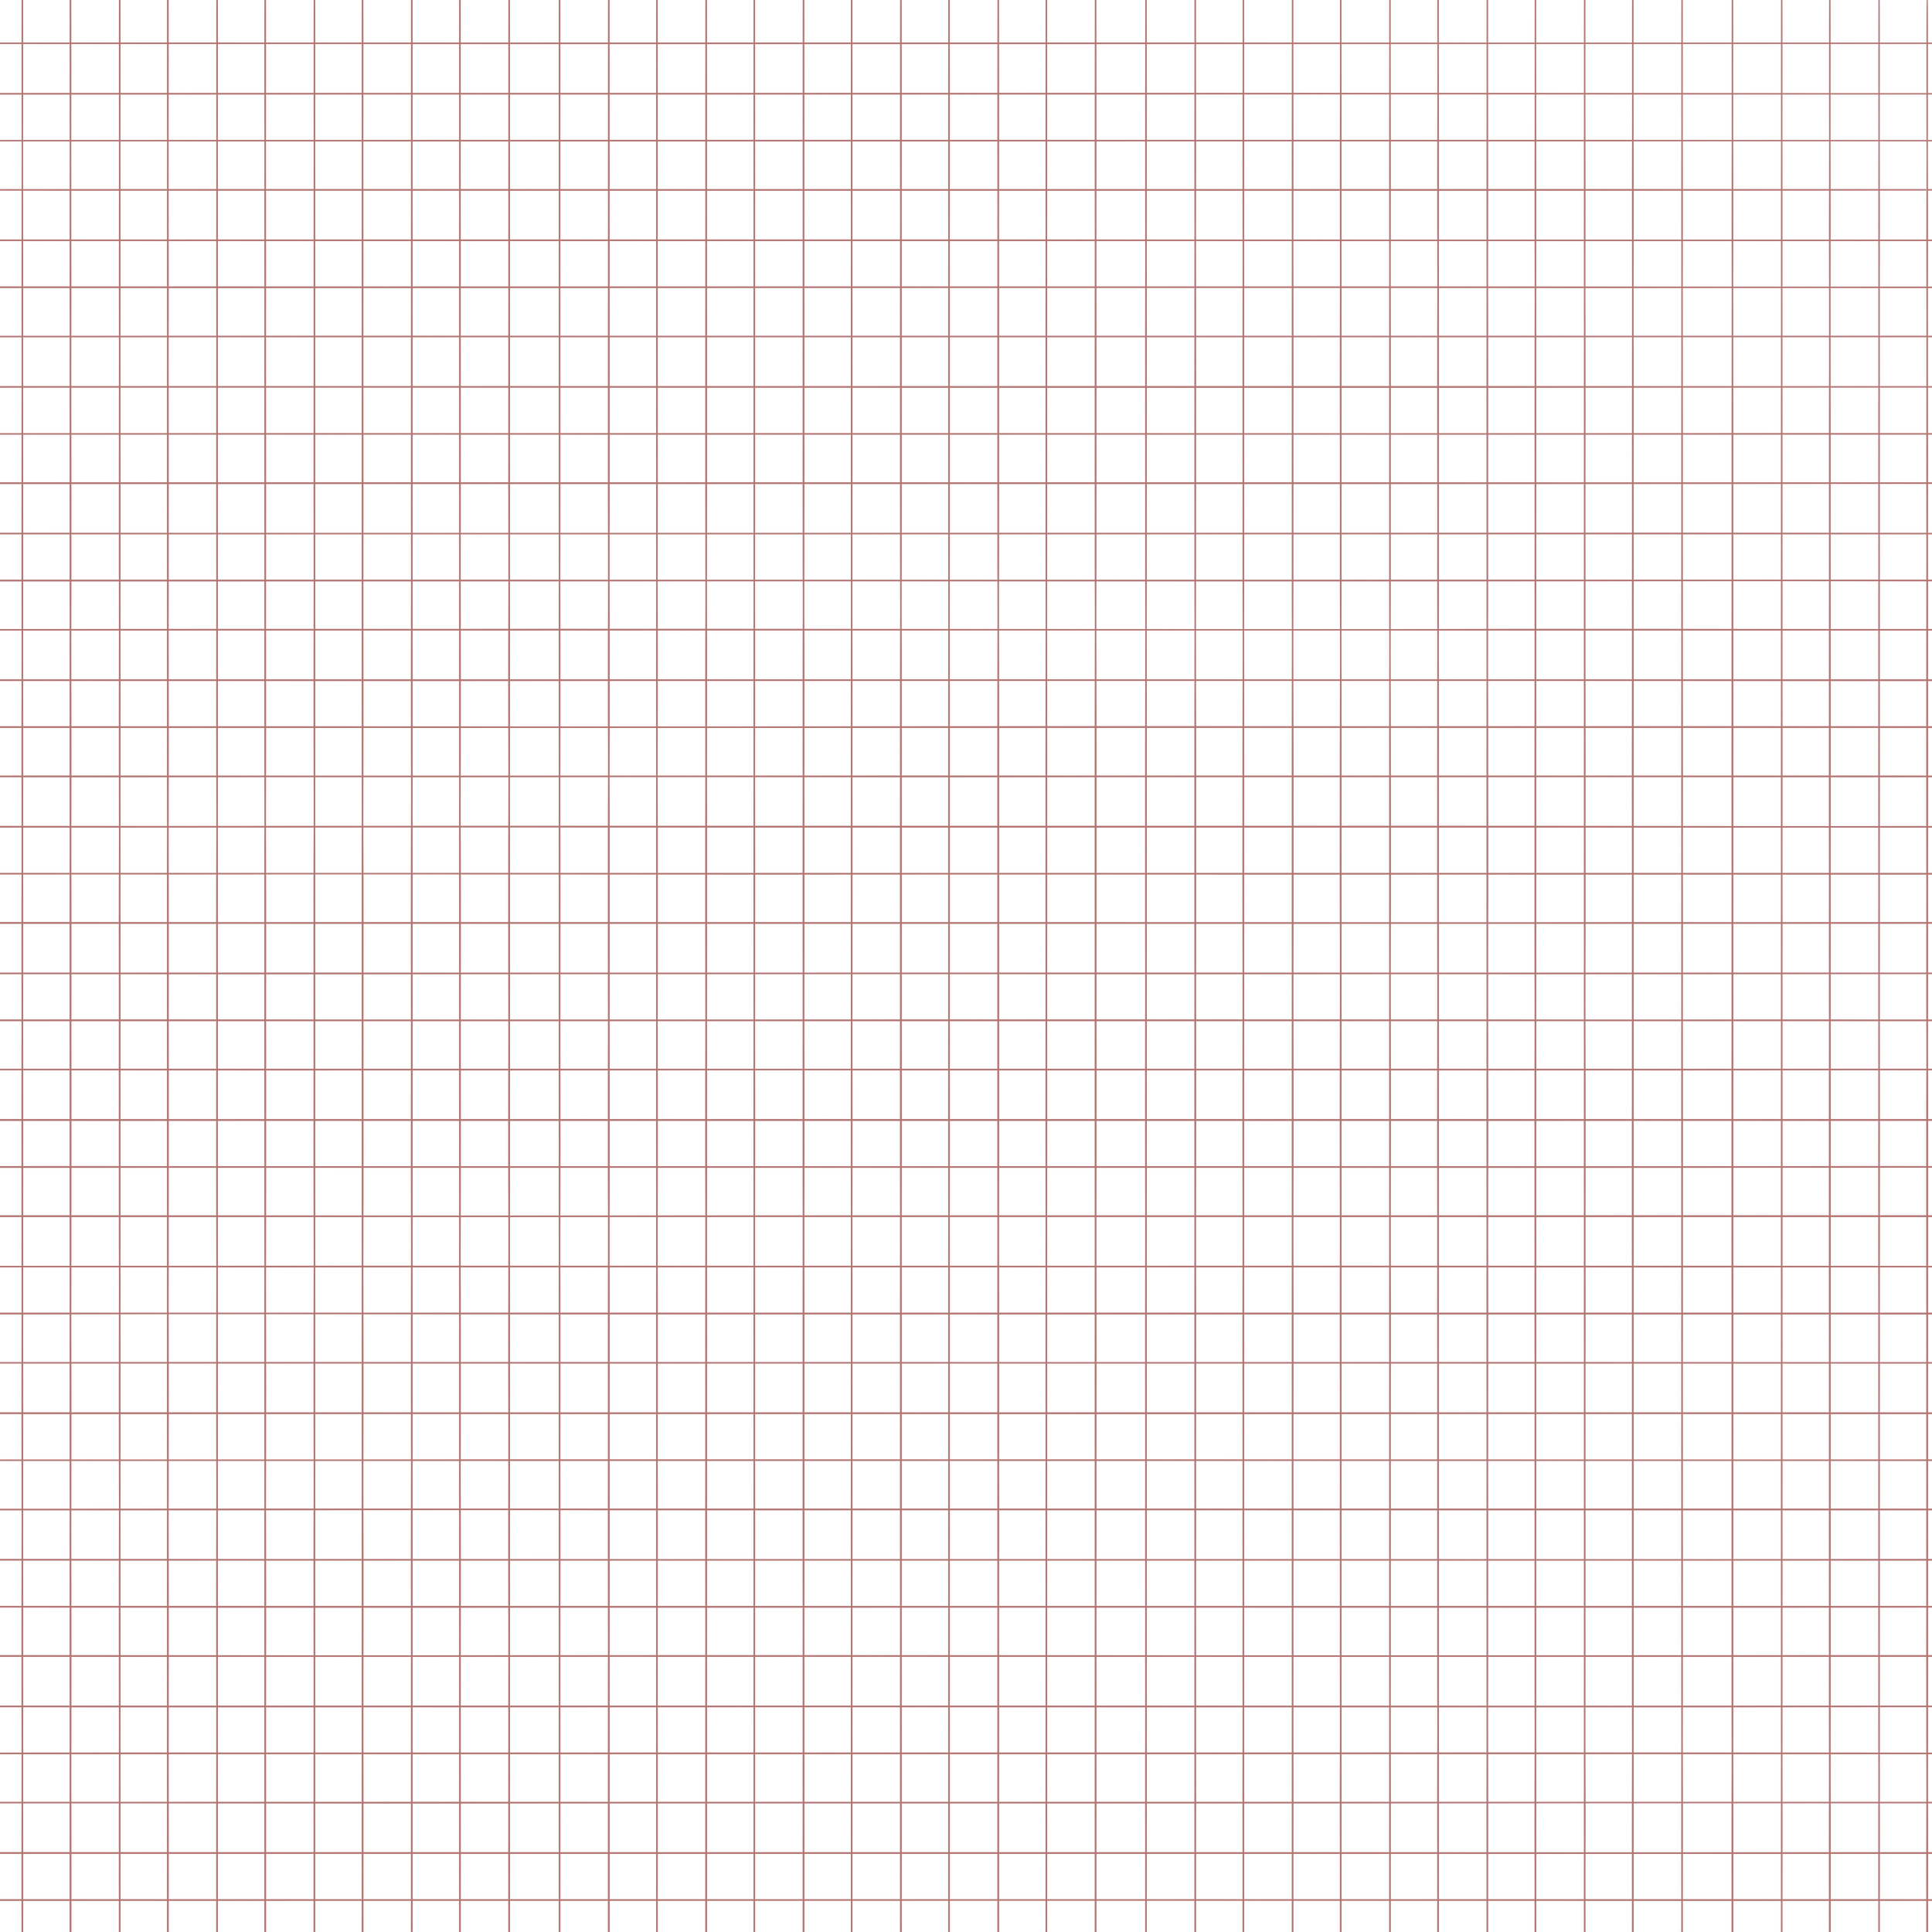





Movie Ticket Reservation System
by Alpha

Slide 2





TABLE OF CONTENT
x
Team Introduction
Introduction
C++ Concepts Used
Flowchart
Code Explanation
Code Demonstration

Slide 3
Alpha :
Somony
Leyli
Ayla
Khadija

Slide 4
Introduction
x
This project is a Movie Ticket Reservation System that allows users to book seats for different movies, ensuring that each movie has a separate seating chart.

Slide 5
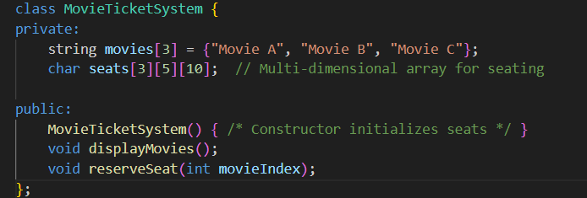

C++ Concepts Used in the Project
3. Vectors (STL) for Dynamic Data Storage
1. Classes & Objects (OOP)
Vectors are useful because they grow dynamically as reservations increase.
This makes our code reusable and well-organized.
4. Functions & Modular Programming
Each function handles a specific task, making debugging easier.
2. Arrays & Multi-Dimensional Arrays
Using arrays helps efficiently manage seat reservations.

Slide 6

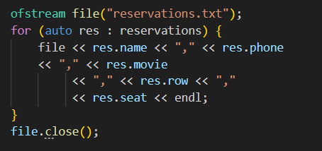
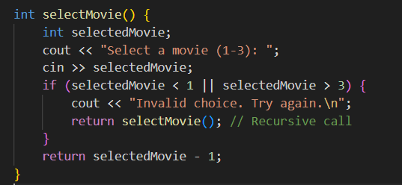
C++ Concepts Used in the Project
7. File Handling
5. Loops & Conditional Statements
This ensures users can't book an already reserved seat.
This allows users to retrieve their reservations later.
6. Recursion for Input Validation
This ensures only valid inputs are accepted.

Slide 7

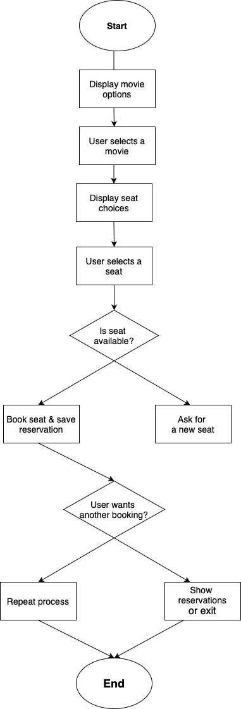
Flowchart
This flowchart represents the workflow of our Movie Ticket Reservation System. It starts with movie selection, displays available seats, and allows users to book a seat while ensuring no double bookings.

Slide 8

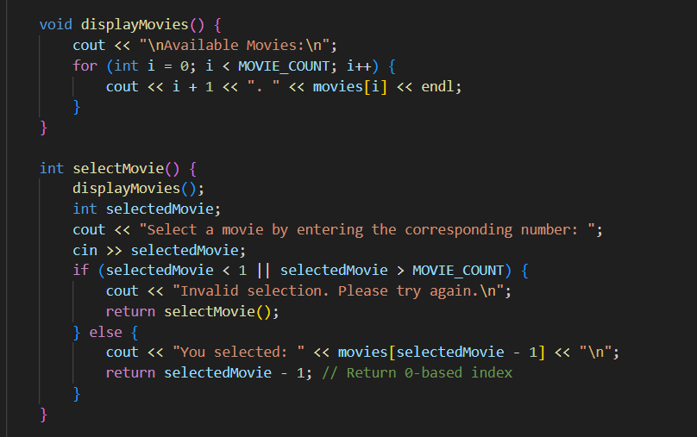
Movie Selection
1
The displayMovies()
function prints the list of available movies.
The selectMovie()
function asks the user to pick a movie. It validates the input and ensures the user selects a correct option.

Slide 9
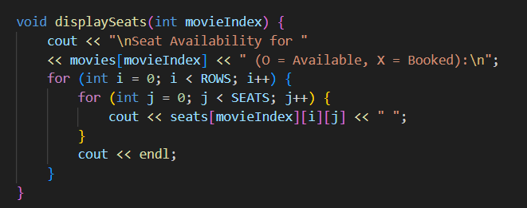
Seat Availability & Display
2
The displaySeats()
function prints the seat chart for a selected movie.
Each movie has its
own seat availability stored in a 3D array (seats[movieIndex][row][seat])

Slide 10

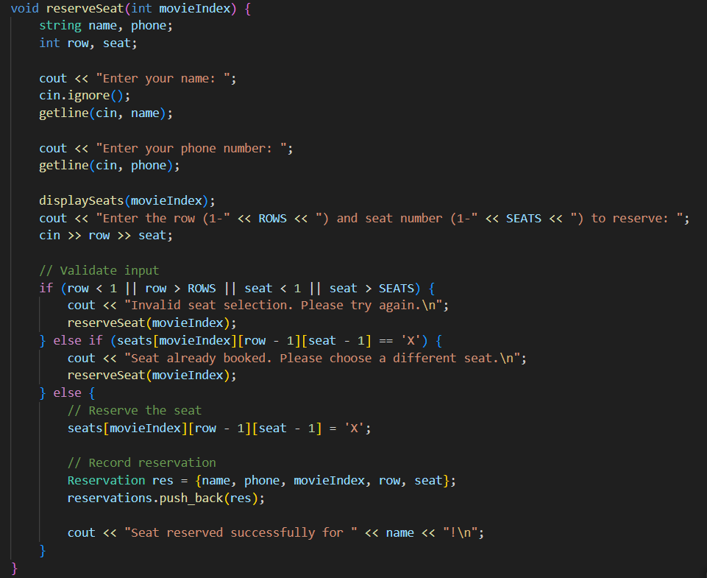
Booking a Seat
3
This function takes
the user’s name, phone number, and seat choice.
It validates the input
and ensures the seat is available before booking.
The seat is marked
‘X’ once booked, and the reservation is stored in the reservations vector.

Slide 11
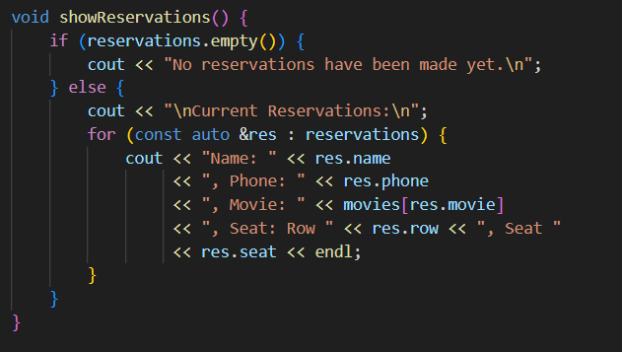
Viewing Reservations
4
This function prints
a list of all booked reservations.
If no bookings exist,
it displays a message: “No reservations have been made yet.”

Slide 12
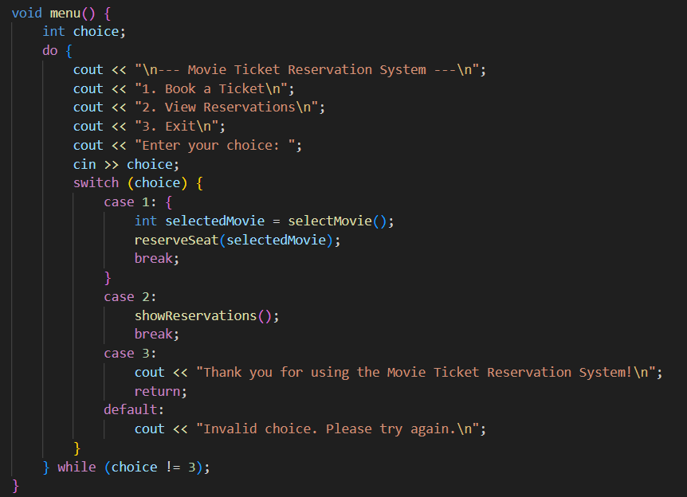
Main Menu System
5
This function controls
the program flow using a menu system.
It allows users to:
1. Book a ticket
2. View reservations
3. Exit the system

Slide 13
Code Demonstration
x

Slide 14
Conclusion
x
This Movie Ticket Reservation System ensures efficient seat booking for multiple movies with separate seating charts. It prevents duplicate bookings and allows users to view their reservations easily.

Slide 15



THANK YOU
Presented by
Alpha

